Slide 1
Study buddy
GUIDED BY,
Dr. S. Vanitha Sivagami
Professor
DAVID PRINCE J , 24BCS038
NAVIEN KUMAR B R, 24BCS053

Slide 2
Introduction
Study Buddy is a web-based learning platform that provides students with a centralized workspace for courses, lessons, assignments, notes, planning, progress tracking, and coding practice. It offers secure authentication and centralized academic resource management.
The platform also includes an integrated coding environment to help students practice programming and improve problem-solving skills. Overall, Study Buddy makes learning more organized, interactive, and effective.

Slide 3
Problem Statement
Students often use multiple platforms to manage courses, assignments, notes, study plans, coding practice, and academic progress. This fragmented approach makes it difficult to organize resources and track learning activities.
Therefore, there is a need for a centralized and user-friendly platform that combines essential academic activities in one place, helping students manage their learning efficiently and monitor their progress.

Slide 4
Objectives
To design and develop an interactive, centralized web-based learning platform that enables students to efficiently manage courses, lessons, assignments, notes, study plans, coding practice, and other academic resources in one unified workspace.

Slide 5
Expected Outcomes
Develop a centralized learning platform for managing courses, lessons, assignments, notes, study plans, and other academic resources in an organized manner.
Create an interactive academic workspace that supports study planning, programming practice, progress tracking, and effective learning management.
Build a secure and user-friendly system that enables students to access, organize, and manage their academic activities efficiently from a single platform.

Slide 6
Dataset Details
Coursera Course Dataset
Course subjects: C, C++, Java, Python, SQL, Web Development
Course levels: Beginner, Intermediate, Advanced
Ratings: 3.5 – 5.0
Certificates: Course, Specialization
Udemy Courses Dataset
Course subjects: C++, Java, Python, JavaScript, SQL, Web Development
Course levels: Beginner, Intermediate, Expert
Prices: Free
Duration: 1 – 50+ hours

Slide 7
Working Environment
Frontend: React.js, HTML5, CSS3, JavaScript
Backend: Node.js, Express.js
Database: MongoDB
Authentication: JWT-based authentication
Programming Execution: Judge0 API
Development Environment: Visual Studio Code
Version Control: Git and GitHub
Browser: Google Chrome / BRAVE

Slide 8
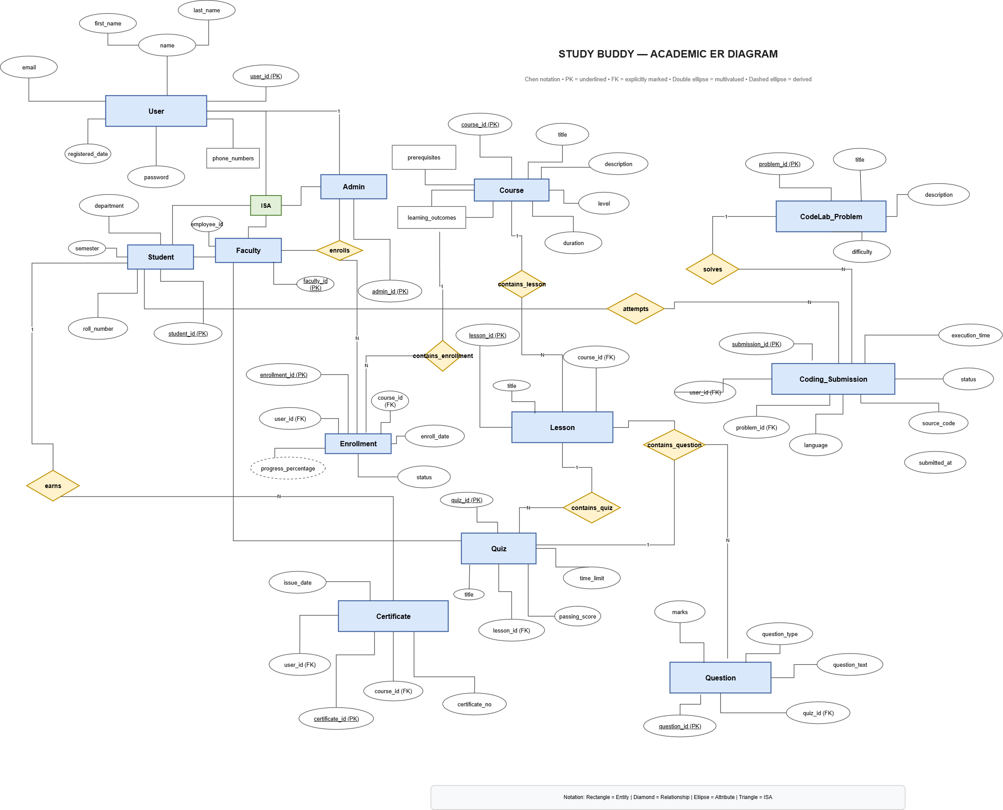
ER Diagram
ER DIAGRAM.png

Slide 9
Database Schema Diagram
SCHEMA DIAGRAM.webp

Slide 10
Module Descriptions
Authentication – Registration, login, and secure profile access.
Courses – Browse courses, lessons, and learning resources.
Assignments – Access and complete course-related assignments.
Planner – Organize study schedules and academic tasks.
Notes – Create and manage personal study notes.
Progress – Track learning progress, XP, achievements, and completion.
CodeLab – Practice programming and execute code using Judge0.
Profile – Manage profile, certificates, badges, and statistics.

Slide 11
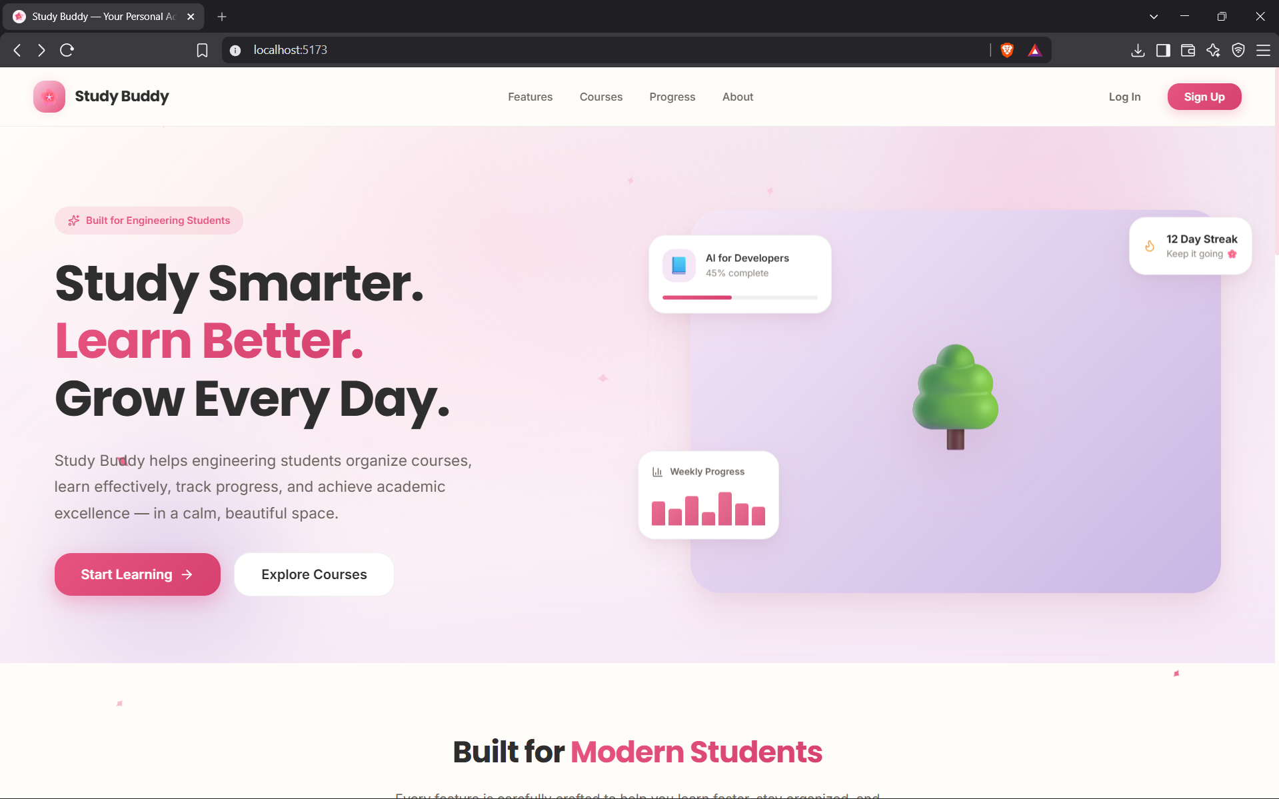
Fig 1.1 LANDING PAGE

Slide 12
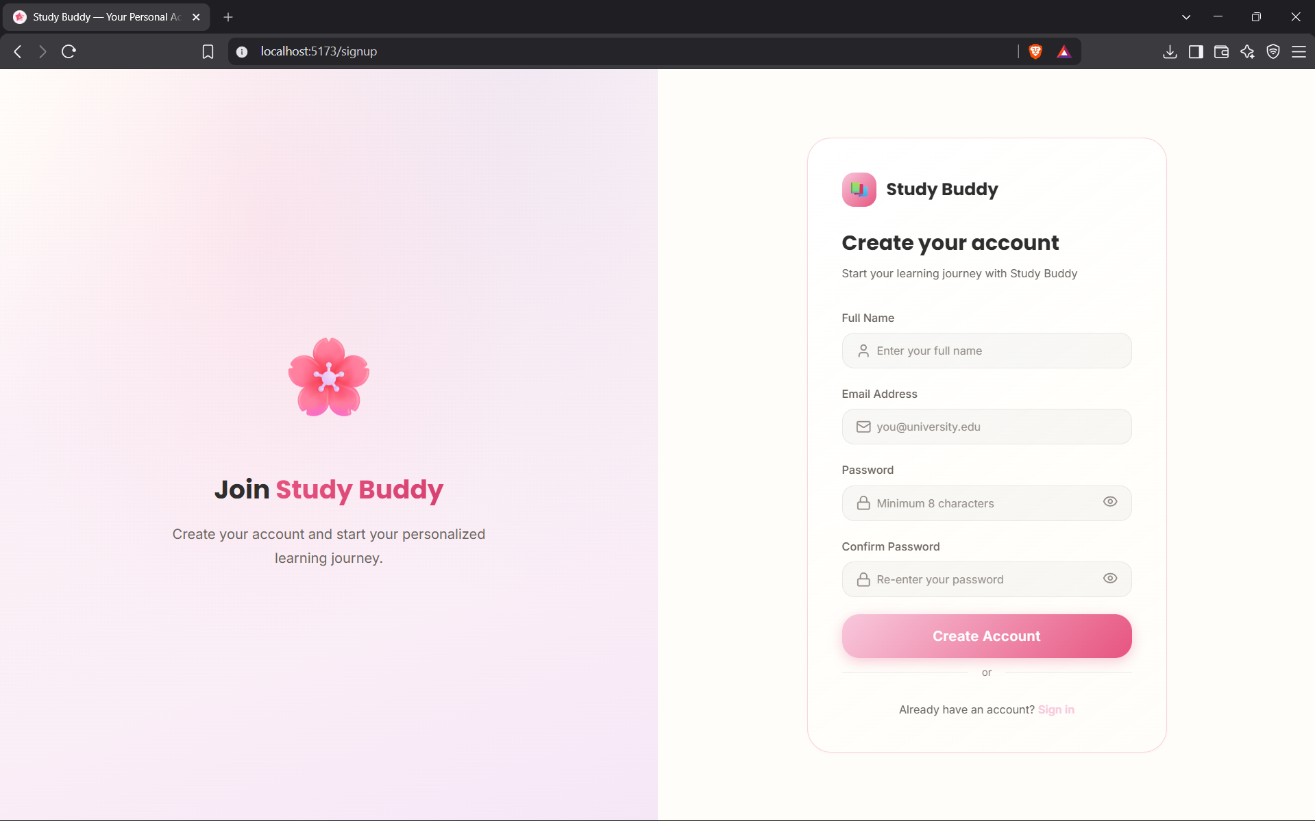
Fig 1.2 USER AUTHENTICATION

Slide 13
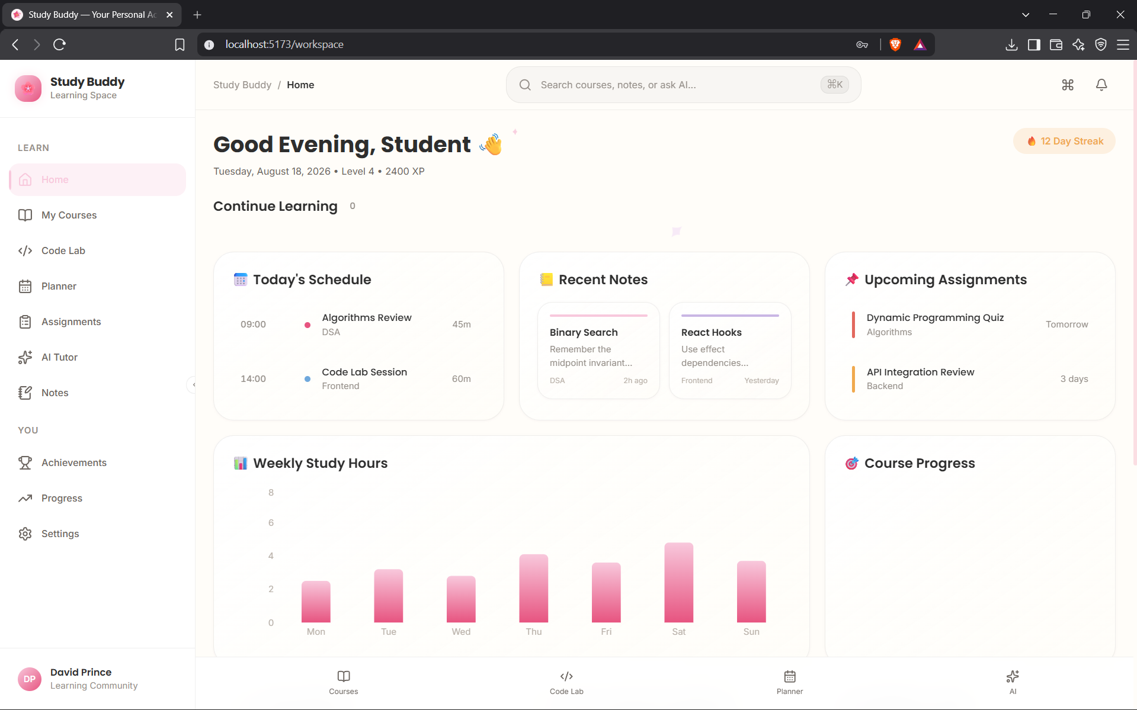
Fig 1.3 Student Dashboard

Slide 14
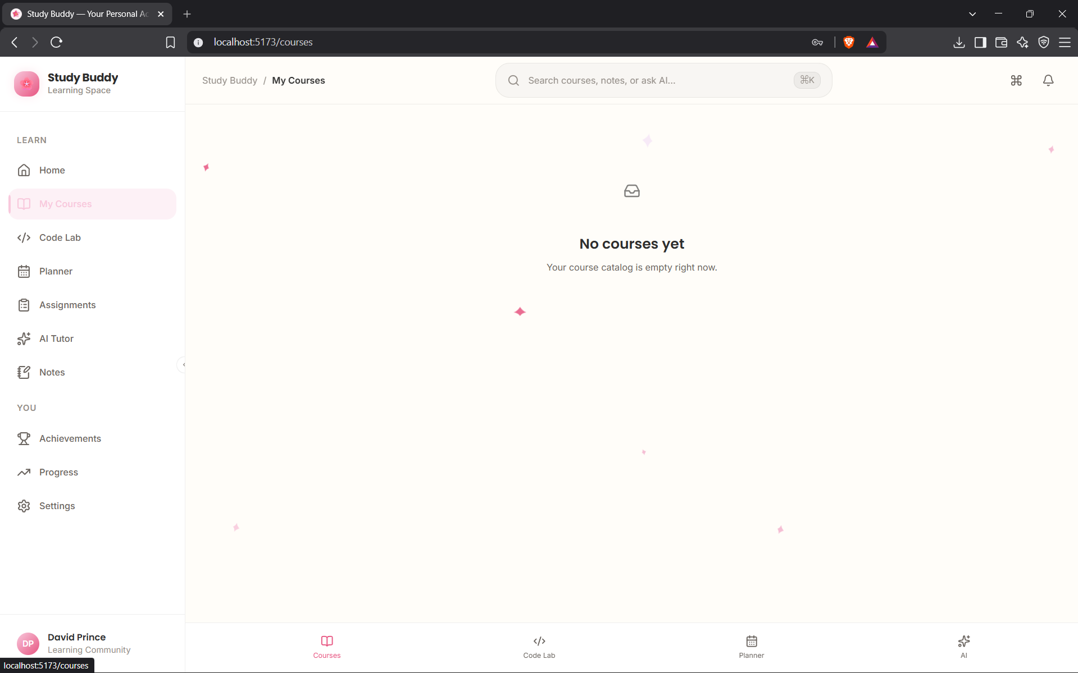
Fig 1.4 COURSE MANAGEMENT

Slide 15
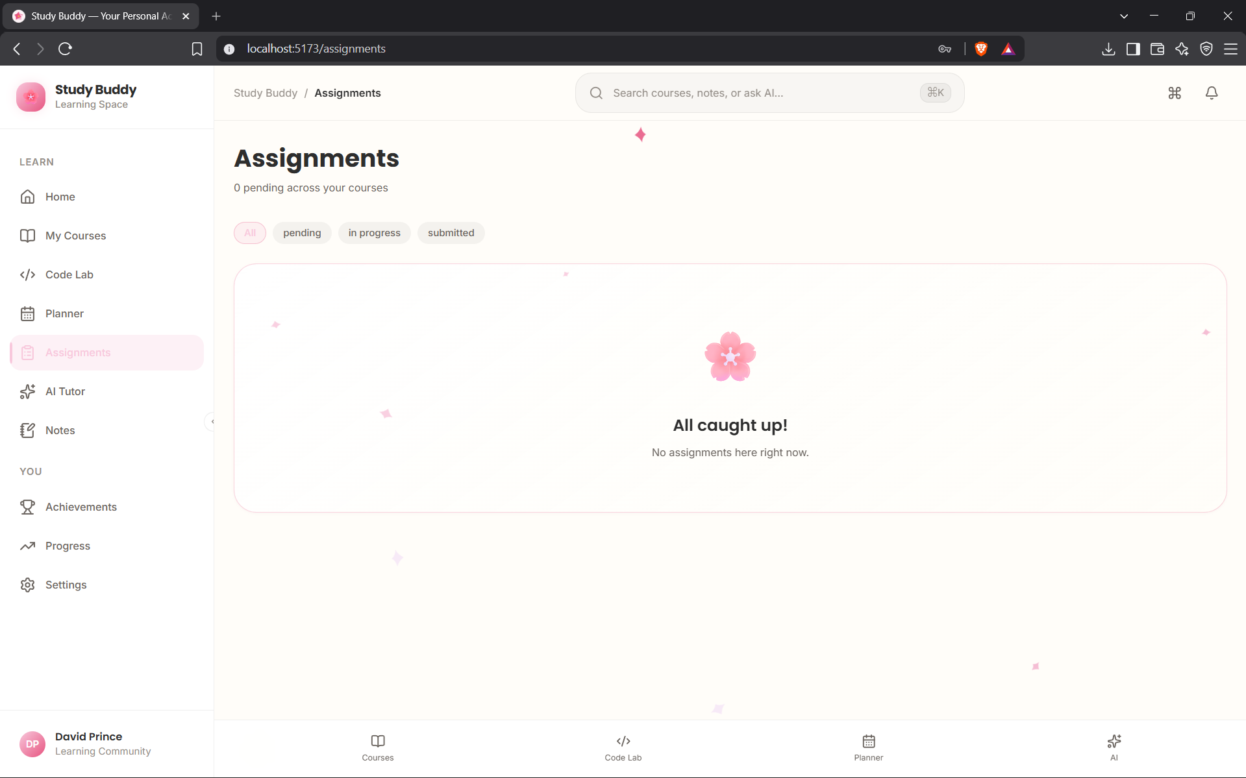
Fig 1.5 ASSIGNMENT PAGE

Slide 16
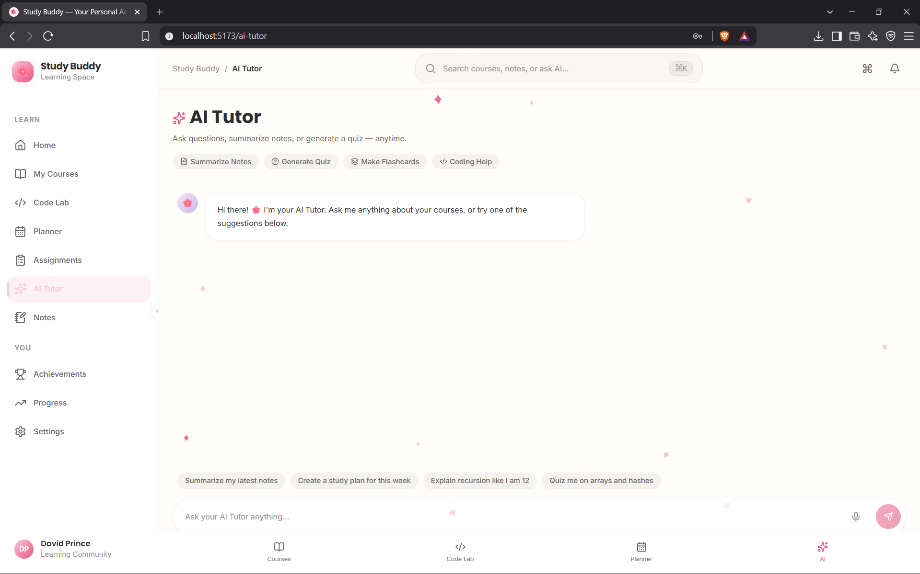
Fig 1.6 CHATBOT PAGE

Slide 17
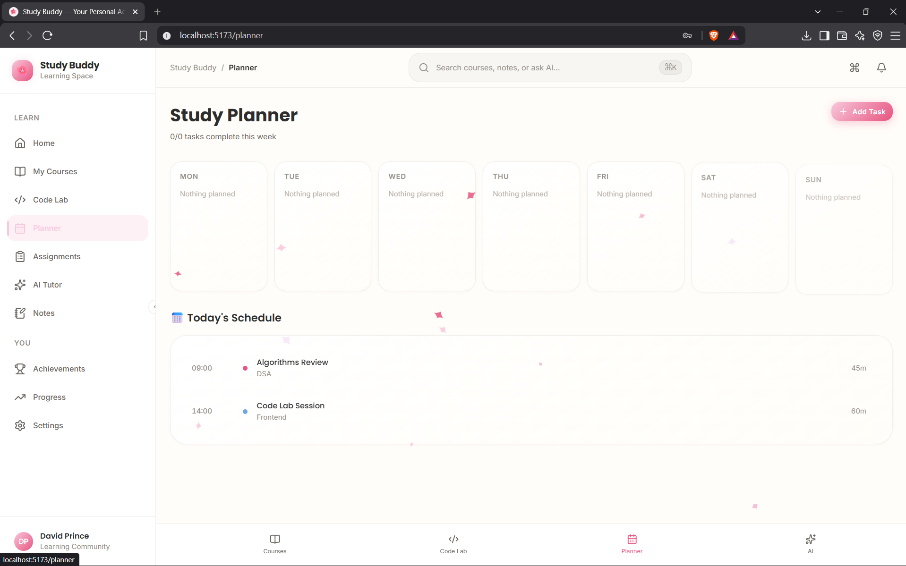
Fig 1.7 Study Planner

Slide 18
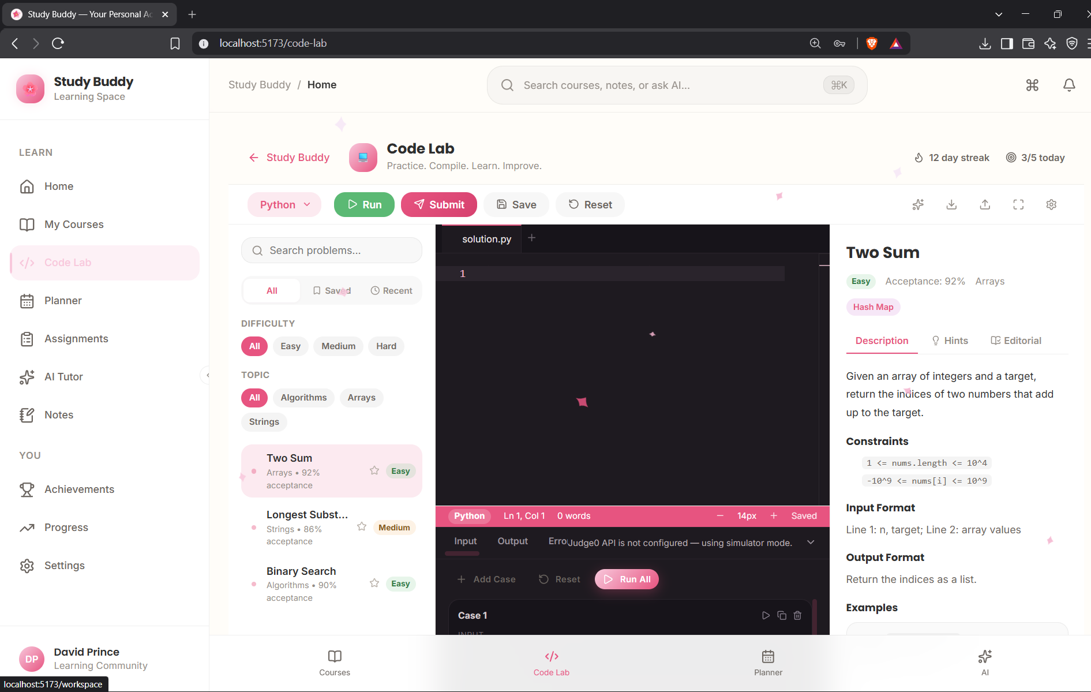
Fig 1.8 Code Lab

Slide 19
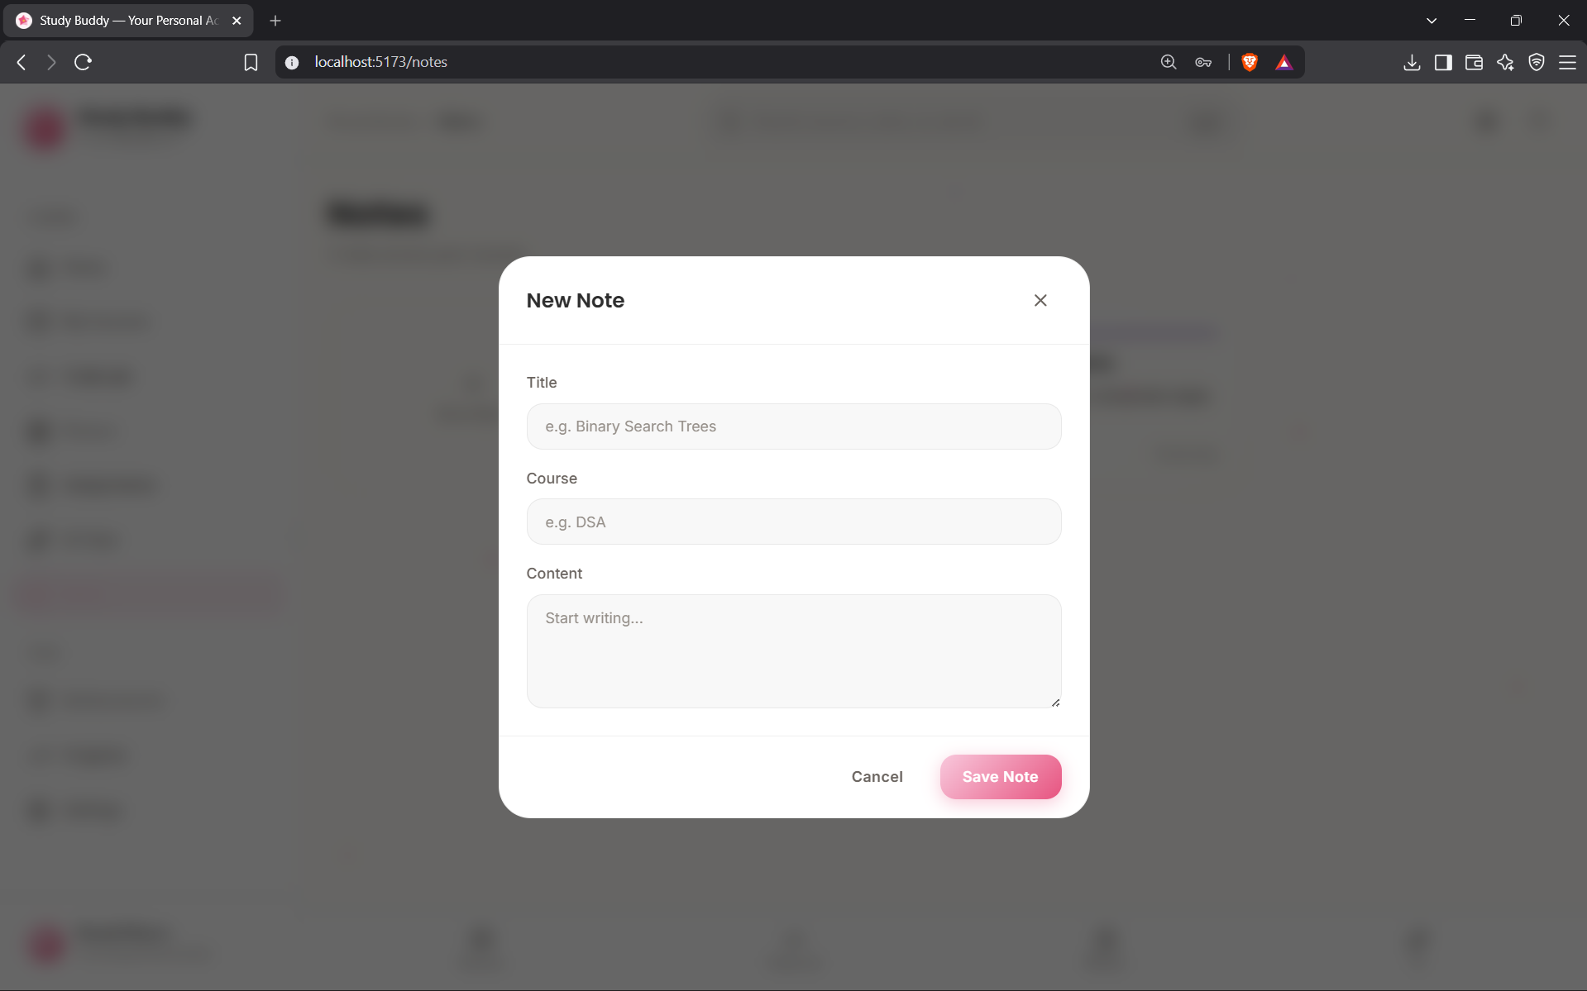
Fig 1.9 Add Notes

Slide 20
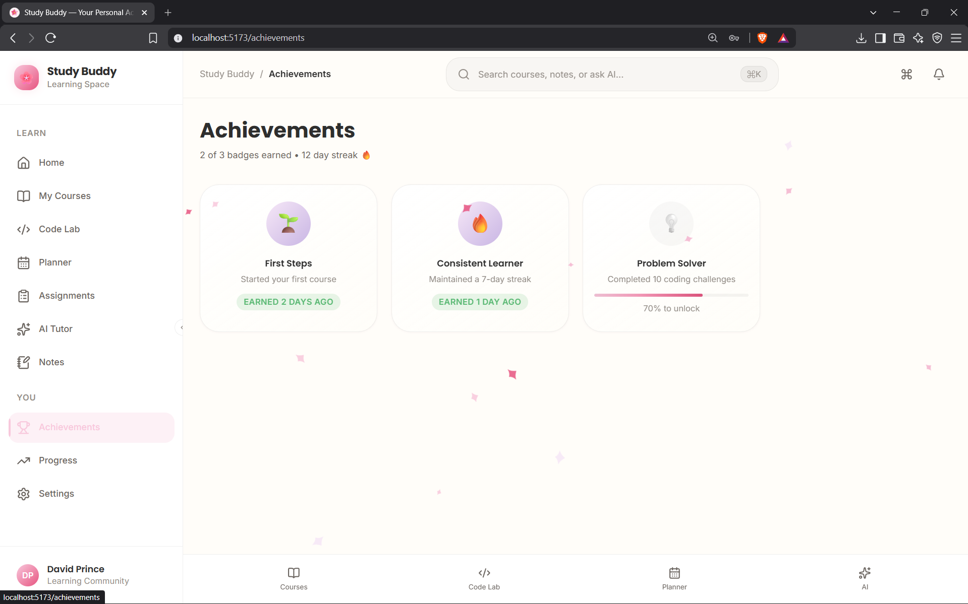
Fig 1.10 Achievements

Slide 21
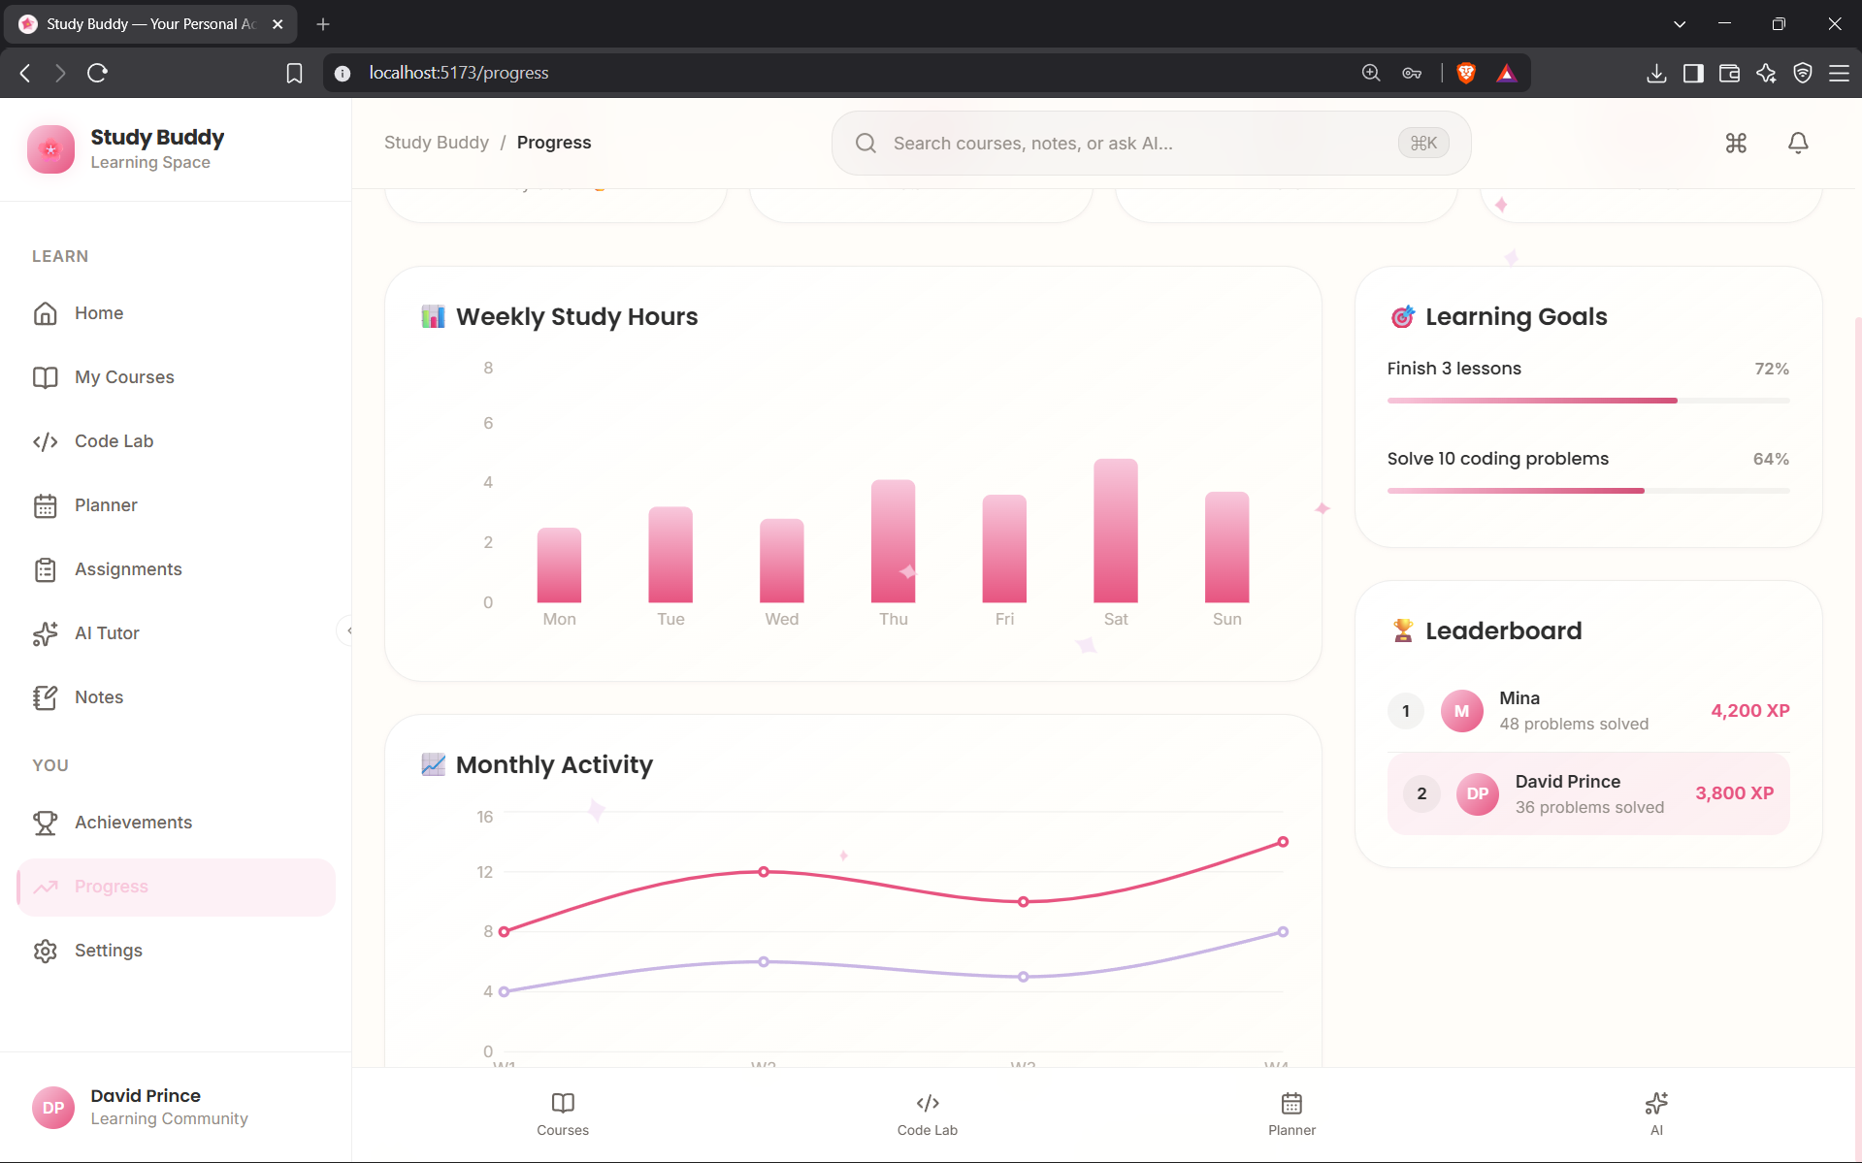
Fig 1.11 Progress Page

Slide 22
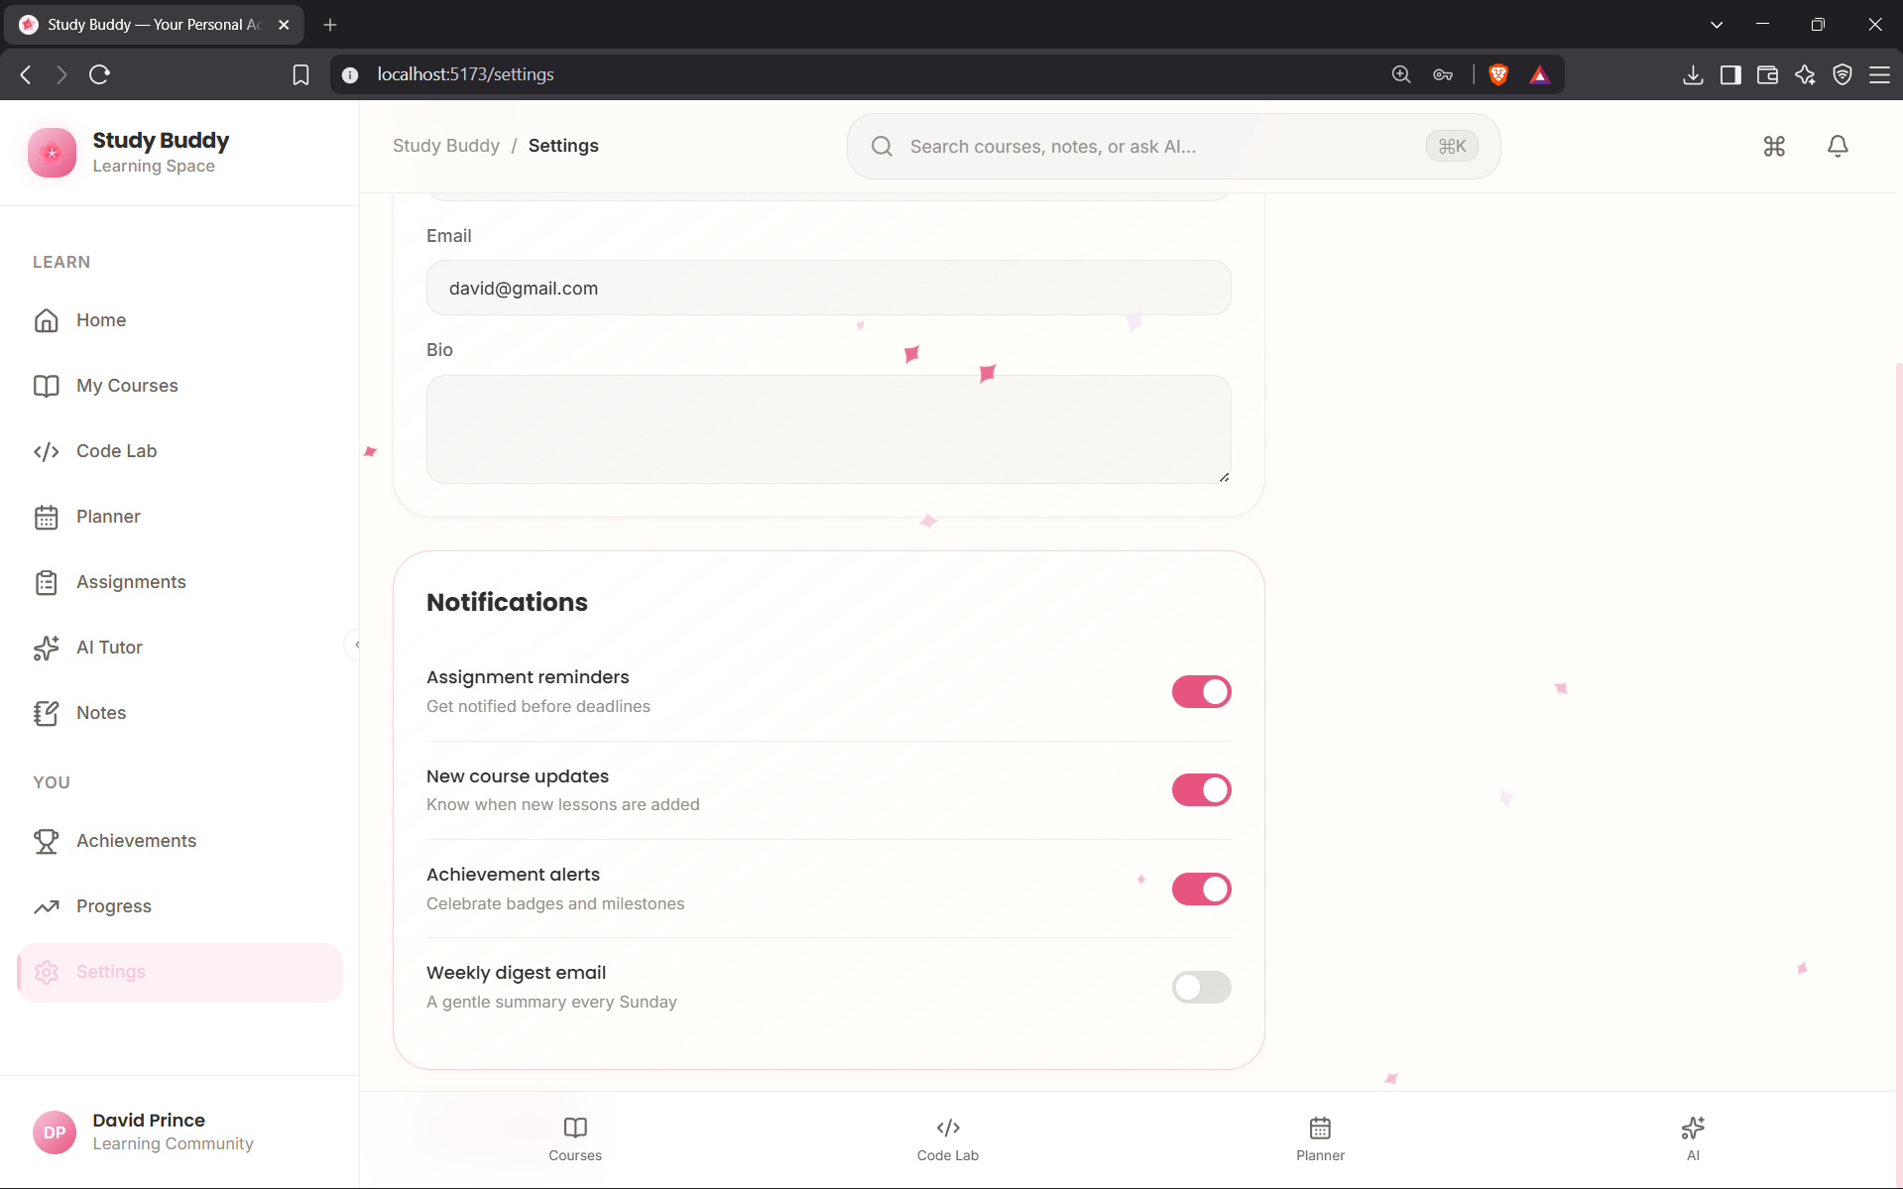
Fig 1.12 Settings

Slide 23
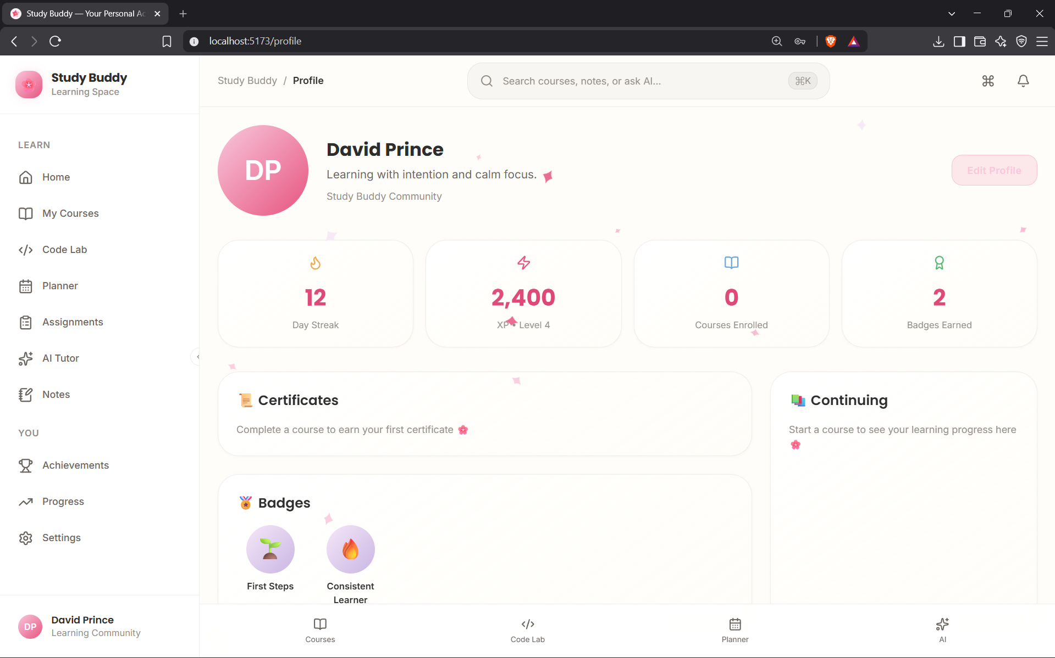
Fig 1.13 Profile Page

Slide 24
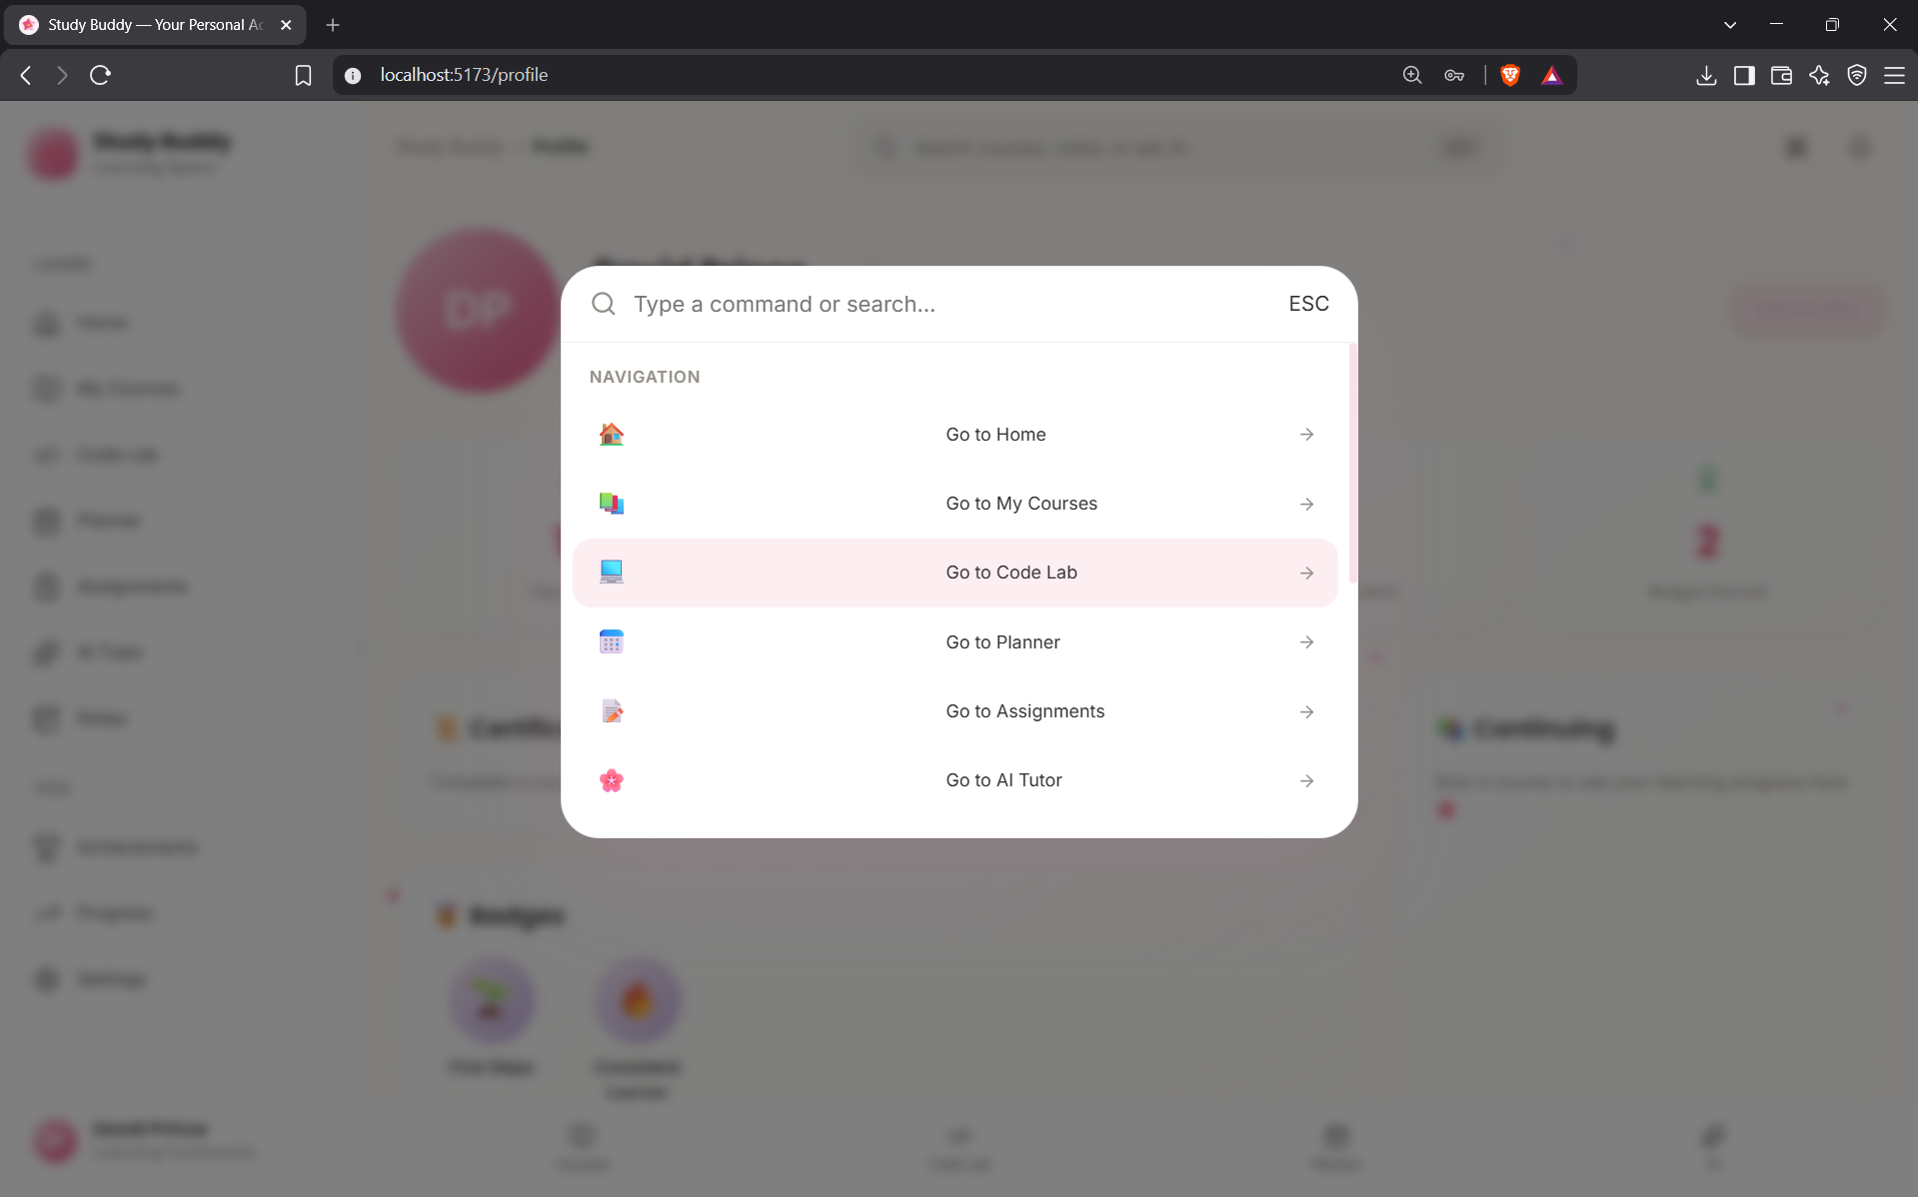
Fig 1.14 Search Bar

Slide 25
REFERENCES
React Documentation — https://react.dev/
Vite Documentation — https://vite.dev/guide/
Express.js Documentation — https://expressjs.com/
MongoDB Documentation — https://www.mongodb.com/docs/
Judge0 Documentation — https://docs.judge0.com/
Coursera Course Dataset – Kaggle — https://www.kaggle.com/datasets/siddharthm1698/coursera-course-dataset
Udemy Courses Dataset – Kaggle — https://www.kaggle.com/datasets/andrewmvd/udemy-courses

Slide 26
Thank You

